Slide 1
PRICING UNDER DIFFERENT MARKET STRUCTURES
Oligopoly

Slide 2
Oligopoly
An oligopoly is a market structure characterized by:
  Few firms
  Interdependence
  Either standardized or differentiated products
  Difficult entry

Slide 3
Characteristics of Oligopoly
Oligopolies are made up of a small number of firms in an industry
In any decision a firm makes, it must take into account the expected reaction of other firms
Oligopolistic firms are mutually interdependent
Oligopolies can be collusive or noncollusive
Firms may engage in strategic decision making where each firm takes explicit account of a rival’s expected response to a decision it is making
16-<number>

Slide 4
Interdependence
A key characteristic of oligopolies is that each firm can affect the market, making each firm’s choices dependent on the choices of the other firms. They are interdependent.

Slide 5
Interdependence
The importance of interdependence is that it leads to strategic behavior.
Strategic behavior is the behavior that occurs when what is best for A depends upon what B does, and what is best for B depends upon what A does.
Oligopolistic behavior includes both ruthless competition and cooperation.

Slide 6
Models of Oligopoly Behavior
No single general model of oligopoly behavior exists.

Slide 7
Models of Oligopoly Behavior
There is no single model of oligopoly behavior
An oligopoly model can take two extremes:
The cartel model is when a combination of firms acts as if it were a single firm and a monopoly price is set
The contestable market model is a model of oligopolies where barriers to entry and exit, not market structure, determine price and output decisions and a competitive price is set
Other models of oligopolies give price results between the two extremes
16-<number>

Slide 8
The Cartel Model
A cartel model of oligopoly is a model that assumes that oligopolies act as if they were a monopoly and set a price to maximize profit
Output quotas are assigned to individual member firms so that total output is consistent with joint profit maximization
If oligopolies can limit the entry of other firms, they can increase profits
Like collusion, cartels are illegal in India.
16-<number>

Slide 9
Cooperation and Cartels
If the firms in an oligopoly cooperate, they may earn more profits than if they act independently.
Collusion, which leads to secret cooperative agreements, is illegal in the India, although it is legal and acceptable in many other countries.
Price-Leadership Cartels may form in which firms simply do whatever a single leading firm in the industry does. This avoids strategic behavior and requires no illegal collusion.
Implicit Price Collusion

Slide 10
Conditions necessary for a cartel to be stable (maintainable):
There are few firms in the industry.
There are significant barriers to entry.
An identical product is produced.
There are few opportunities to keep actions secret.
There are no legal barriers to sharing agreements.

Slide 11
New Entry as a Limit on the
Cartelization Strategy and Price Wars
The threat of outside competition limits oligopolies from acting as a cartel
The threat will be more effective if the outside competitor is much larger than the firms in the oligopoly
Price wars are the result of strategic pricing decisions gone wild
A predatory pricing strategy involves temporarily pushing the price down in order to drive a competitor out of business
16-<number>

Slide 12
OPEC as an Example of a Cartel
OPEC: Organization of Petroleum Exporting Countries.
Attempts to set prices high enough to earn member countries significant profits, but not so high as to encourage dramatic increases in oil exploration or the pursuit of alternative energy sources.
Controls prices by setting production quotas for
member countries.
Such cartels are difficult to sustain because members have large incentives to cheat, exceeding their quotas.

Slide 13
Comparing Contestable Market and Cartel Models
The cartel model is appropriate for oligopolists that collude, set a monopoly price, and prevent market entry
The contestable market model describes oligopolies that set a competitive price and have no barriers to entry
Oligopoly markets lie between these two extremes
Both models use strategic pricing decisions where firms set their price based on the expected reactions of other firms
16-<number>

Slide 14
Implicit Price Collusion
Explicit (formal) collusion is illegal in most countries while implicit (informal) collusion is permitted
Implicit price collusion exists when multiple firms make the same pricing decisions even though they have not consulted with one another
Sometimes the largest or most dominant firm takes the lead in setting prices and the others follow
16-<number>

Slide 15
Facilitating Practices
Facilitating practices are actions by oligopolistic firms that can contribute to cooperation and collusion even though the firms do not formally agree to cooperate.
Cost-plus or mark-up pricing is a pricing policy whereby a firm computes its average costs of producing a product and then sets the price at some percentage above this cost.

Slide 16
Why Are Prices Sticky?
One characteristic of informal collusive behavior is that prices tend to be sticky – they don’t change frequently
Informal collusion is an important reason why prices are sticky
Another is the kinked demand curve
If a firm increases price, others won’t go along, so demand is very elastic for price increases
If a firm lowers price, other firms match the decrease, so demand is inelastic for price decreases
16-<number>

Slide 17
Oligopoly
The principle of the kinked demand curve rests on the principle that:
If a firm raises its price, its rivals will not follow suit
If a firm lowers its price, its rivals will all do the same
If the firm seeks to lower its price to gain a competitive advantage, its rivals will follow suit. Any gains it makes will quickly be lost and the % change in demand will be smaller than the % reduction in price – total revenue would again fall as the firm now faces a relatively inelastic demand curve.
The firm therefore, effectively faces
a ‘kinked demand curve’ forcing it to maintain a stable or rigid pricing structure. Oligopolistic firms may overcome this by engaging in non-price competition.
The kinked demand curve - an explanation for price stability?
Price
Assume the firm is charging a price of N5 and producing an output of 100.
If it chose to raise price above N5, its rivals would not follow suit and the firm effectively faces an elastic demand curve for its product (consumers would buy from the cheaper rivals). The % change in demand would be greater than the % change in price and TR would fall.
Total
Revenue B
N 5
Total Revenue A
Total Revenue A
Total Revenue B
D = elastic
Kinked D Curve
D = Inelastic
100
Quantity

Slide 18
The Kinked Demand Curve Graph
P
A gap in the MR curve exists
A large shift in marginal cost is required before firms will change their price
If P increases, others won’t go along, so D is elastic
MC₁
P
MC₂
Gap
If P decreases, other firms match the decrease, so D is inelastic
MR
D
Q
Q
16-<number>

Slide 19
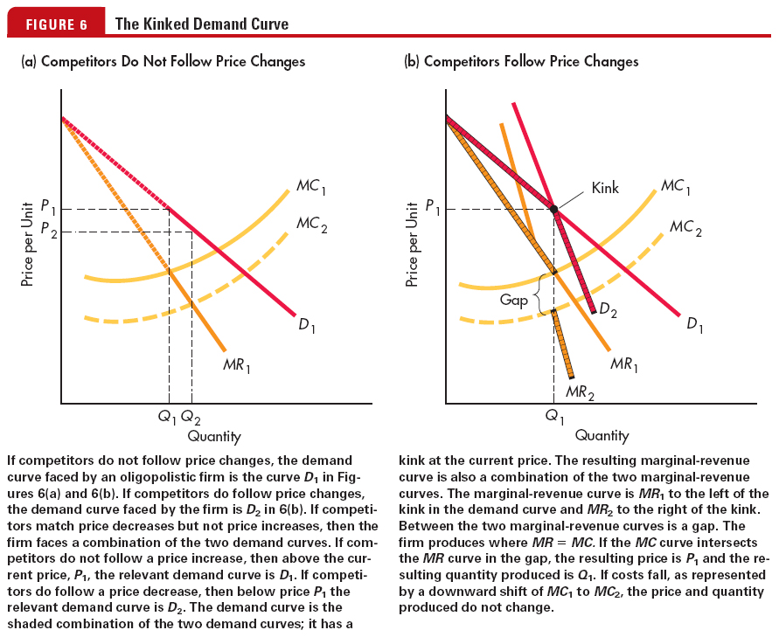
The Kinked Demand Curve

Slide 20
Oligopoly
Competition between the few
  May be a large number of firms in the industry but the industry is dominated by a small number of very large producers
Concentration Ratio – the proportion of total market sales (share) held by the top 3,4,5, etc firms:
  A 4 firm concentration ratio of 75% means the top 4 firms account for 75% of all the sales in the industry

Slide 21
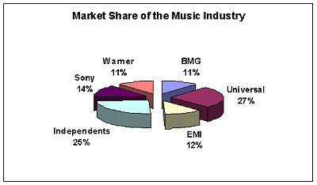
Oligopoly
Example:
Music sales –
The music industry has a 5-firm concentration ratio of 75%. Independents make up 25% of the market but there could be many thousands of firms that make up this ‘independents’ group. An oligopolistic market structure therefore may have many firms in the industry but it is dominated by a few large sellers.

Slide 22

Class Exercise
The kinked demand curve in an oligopolistic market is defined by the equations:
a) Derive equations for the marginal revenue curves.
b) Determine the price and quantity at the "kink" of the demand curve

